Slide 1
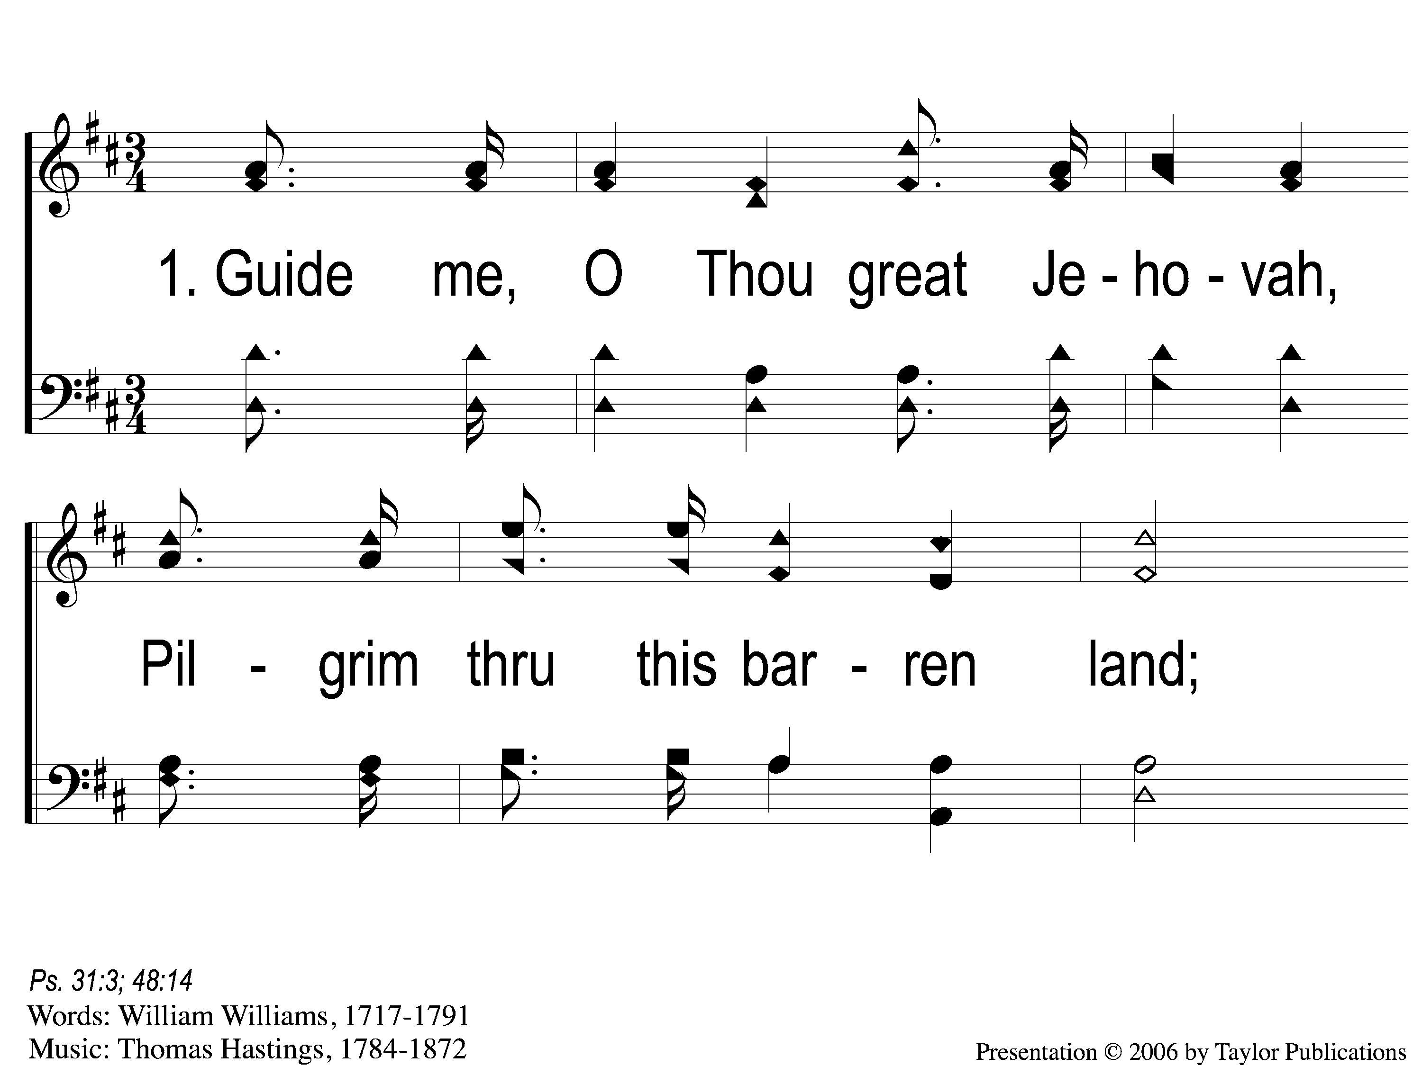
1-1 Guide Me O Thou Great Jehovah
Guide Me, O Thou Great Jehovah
141

Slide 2
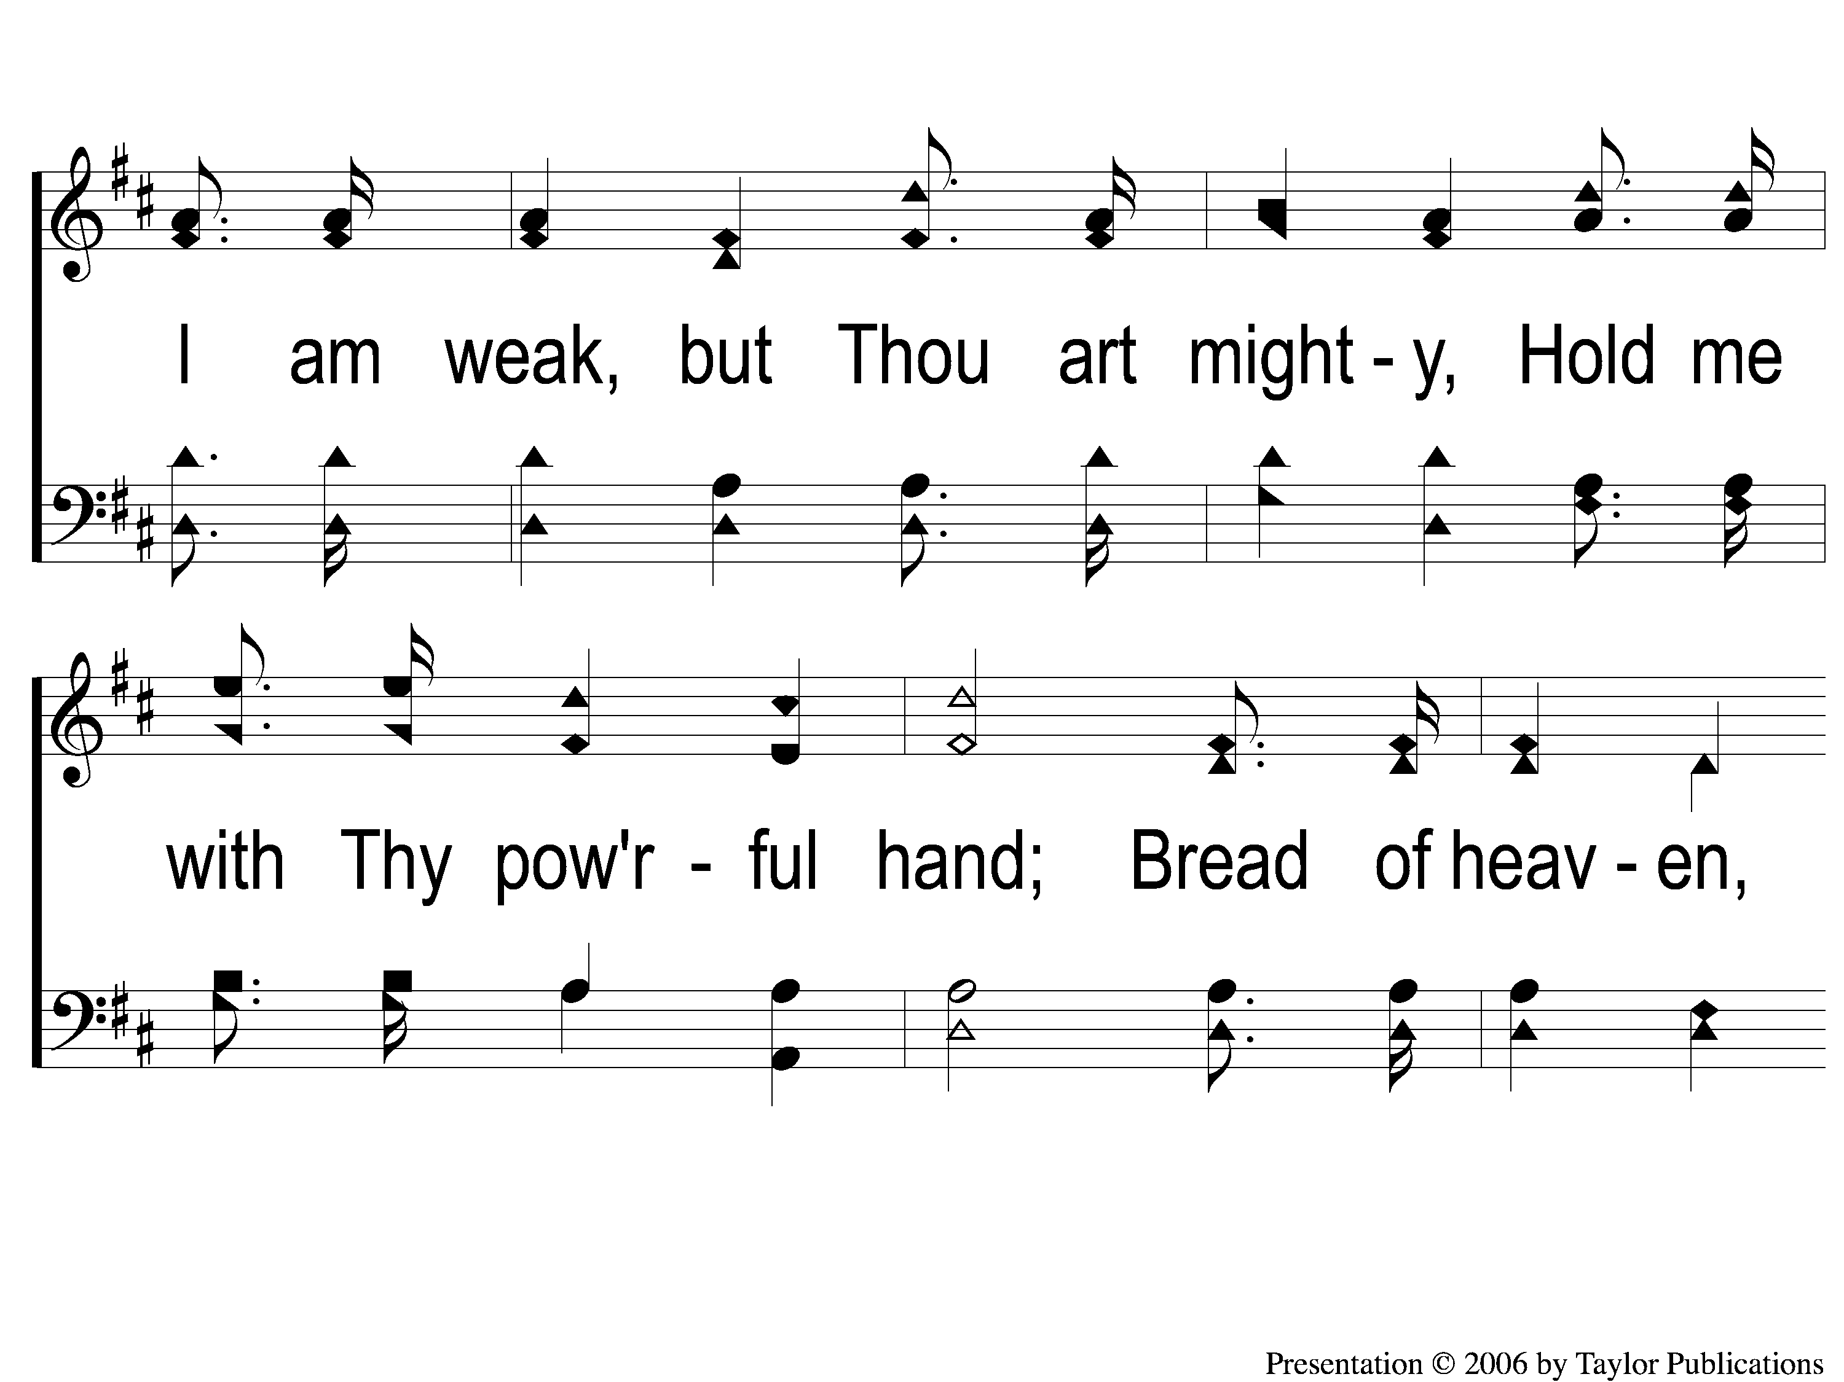
1-2 Guide Me O Thou Great Jehovah
Guide Me, O Thou Great Jehovah
141

Slide 3
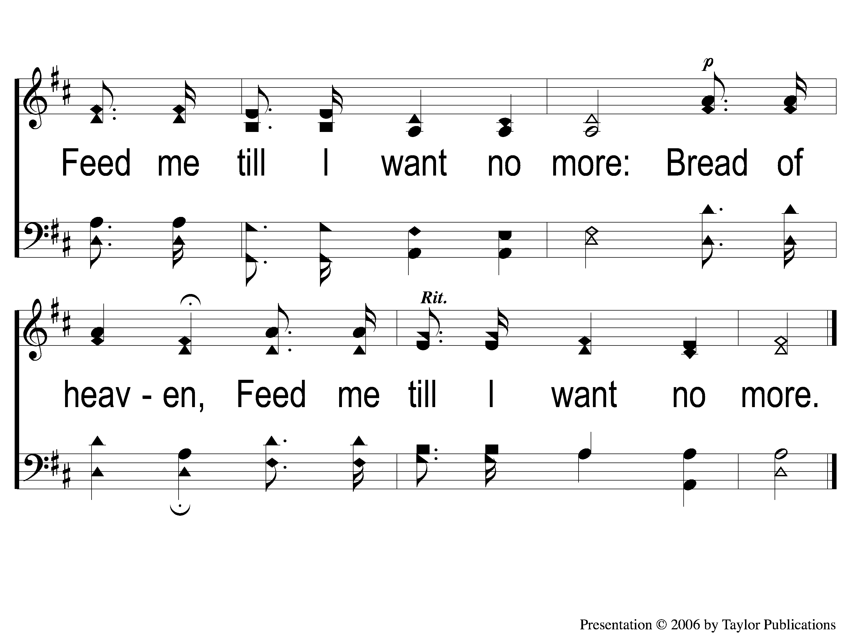
1-3 Guide Me O Thou Great Jehovah
Guide Me, O Thou Great Jehovah
141

Slide 4
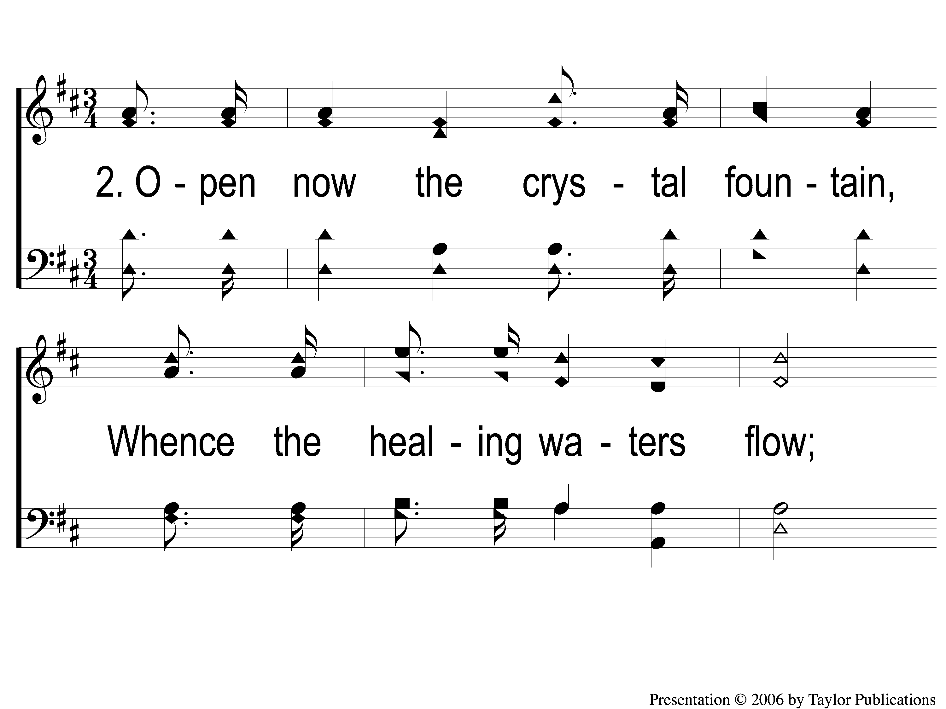
2-1 Guide Me O Thou Great Jehovah
Guide Me, O Thou Great Jehovah
141

Slide 5
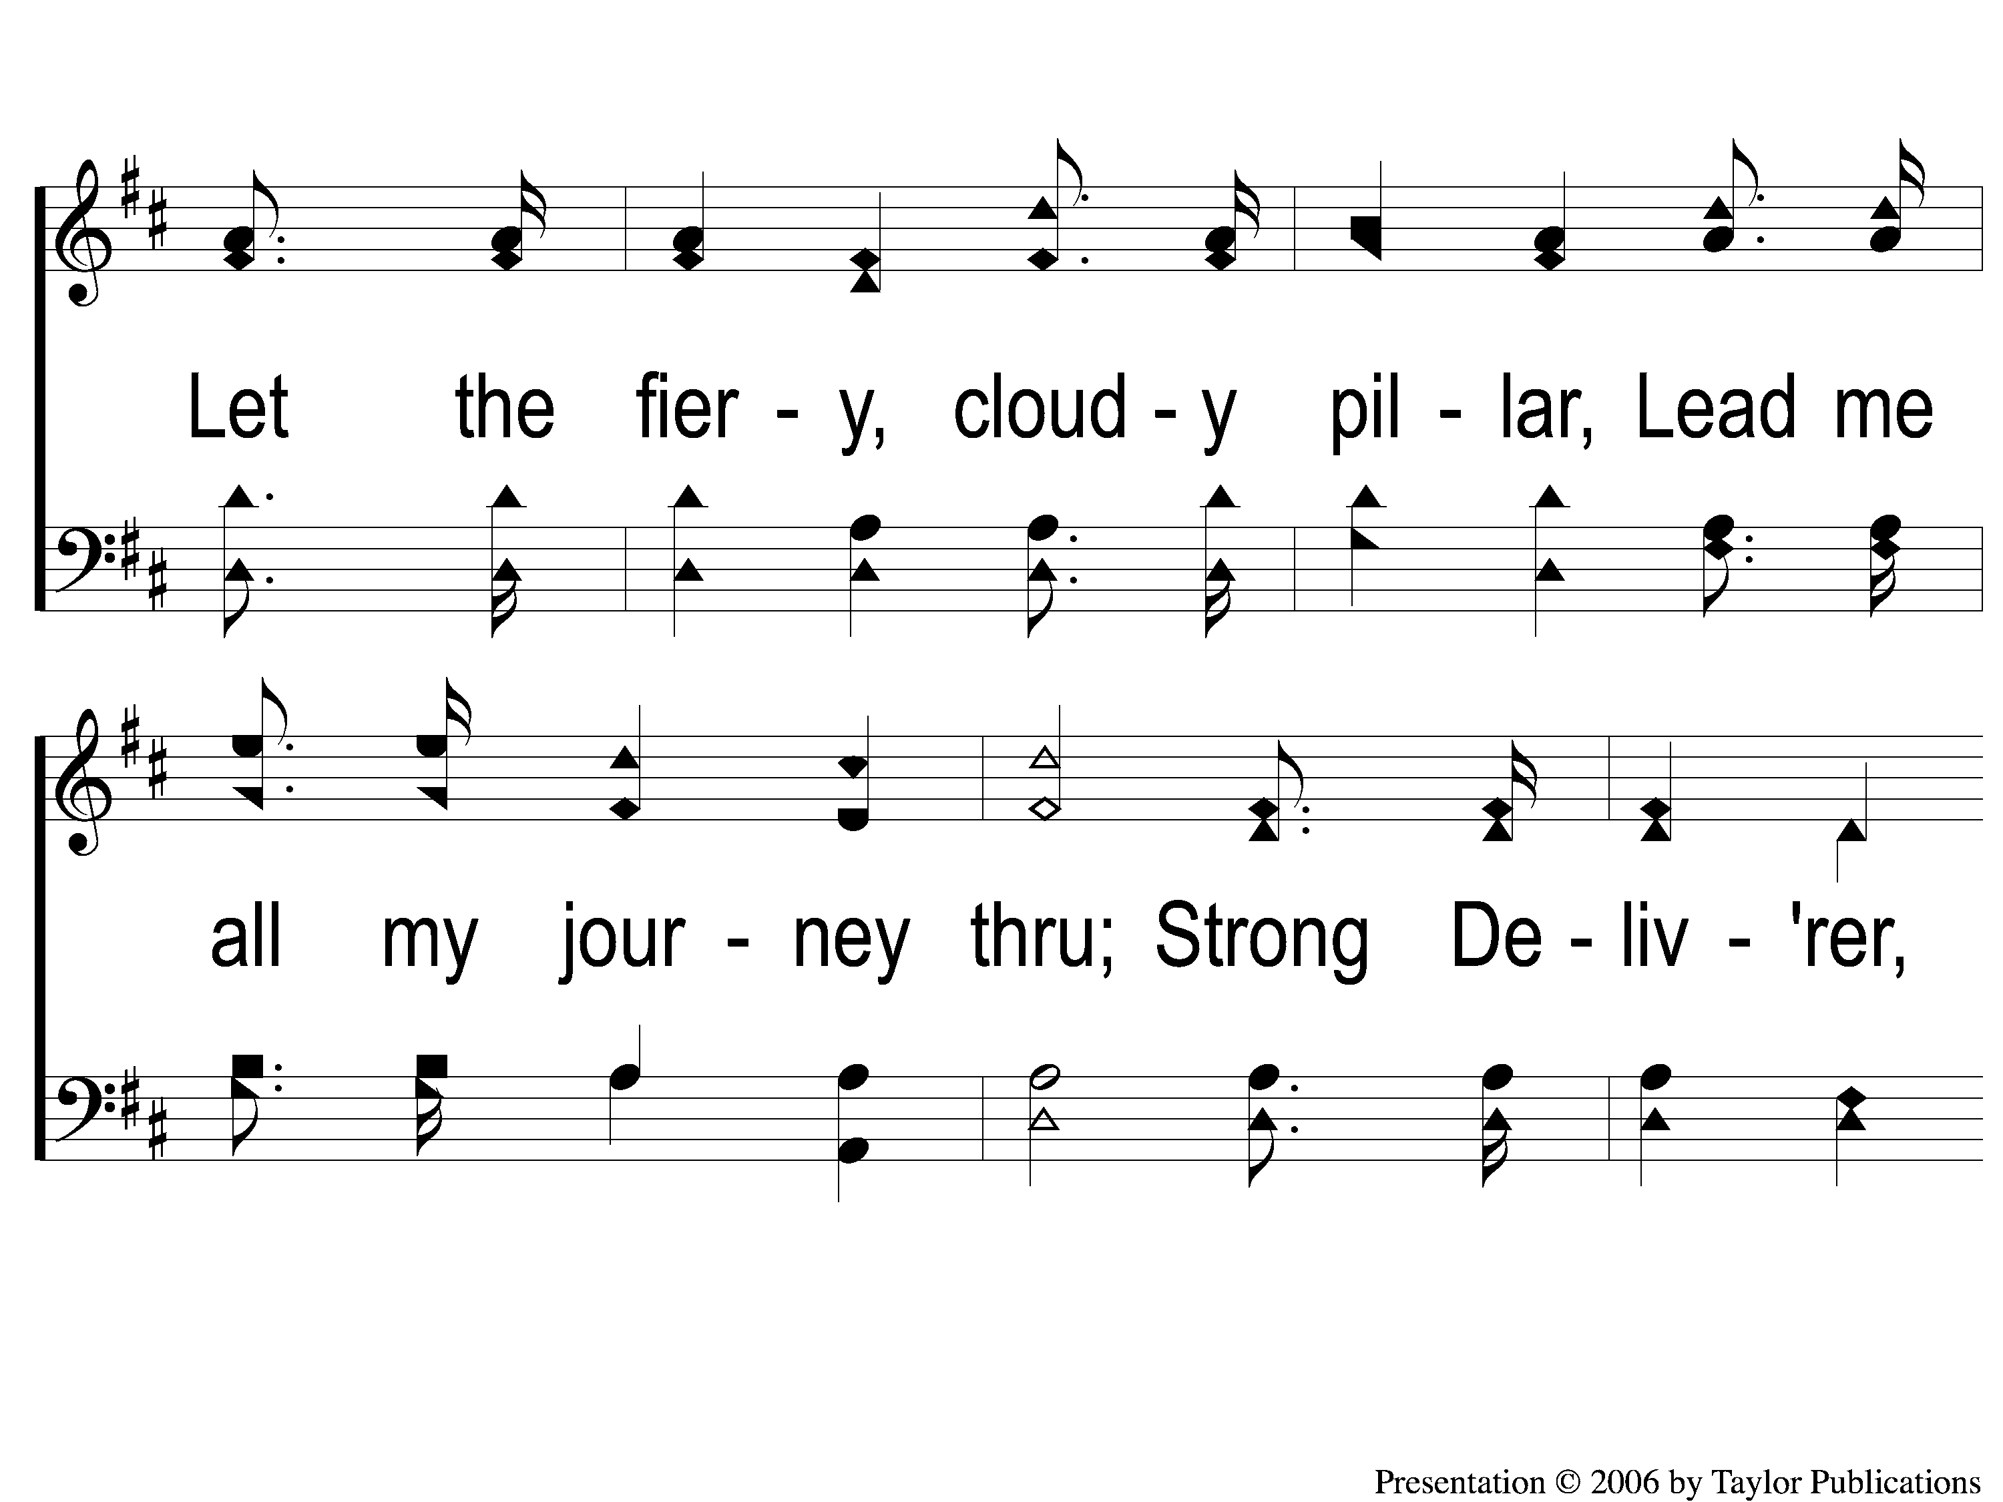
2-2 Guide Me O Thou Great Jehovah
Guide Me, O Thou Great Jehovah
141

Slide 6
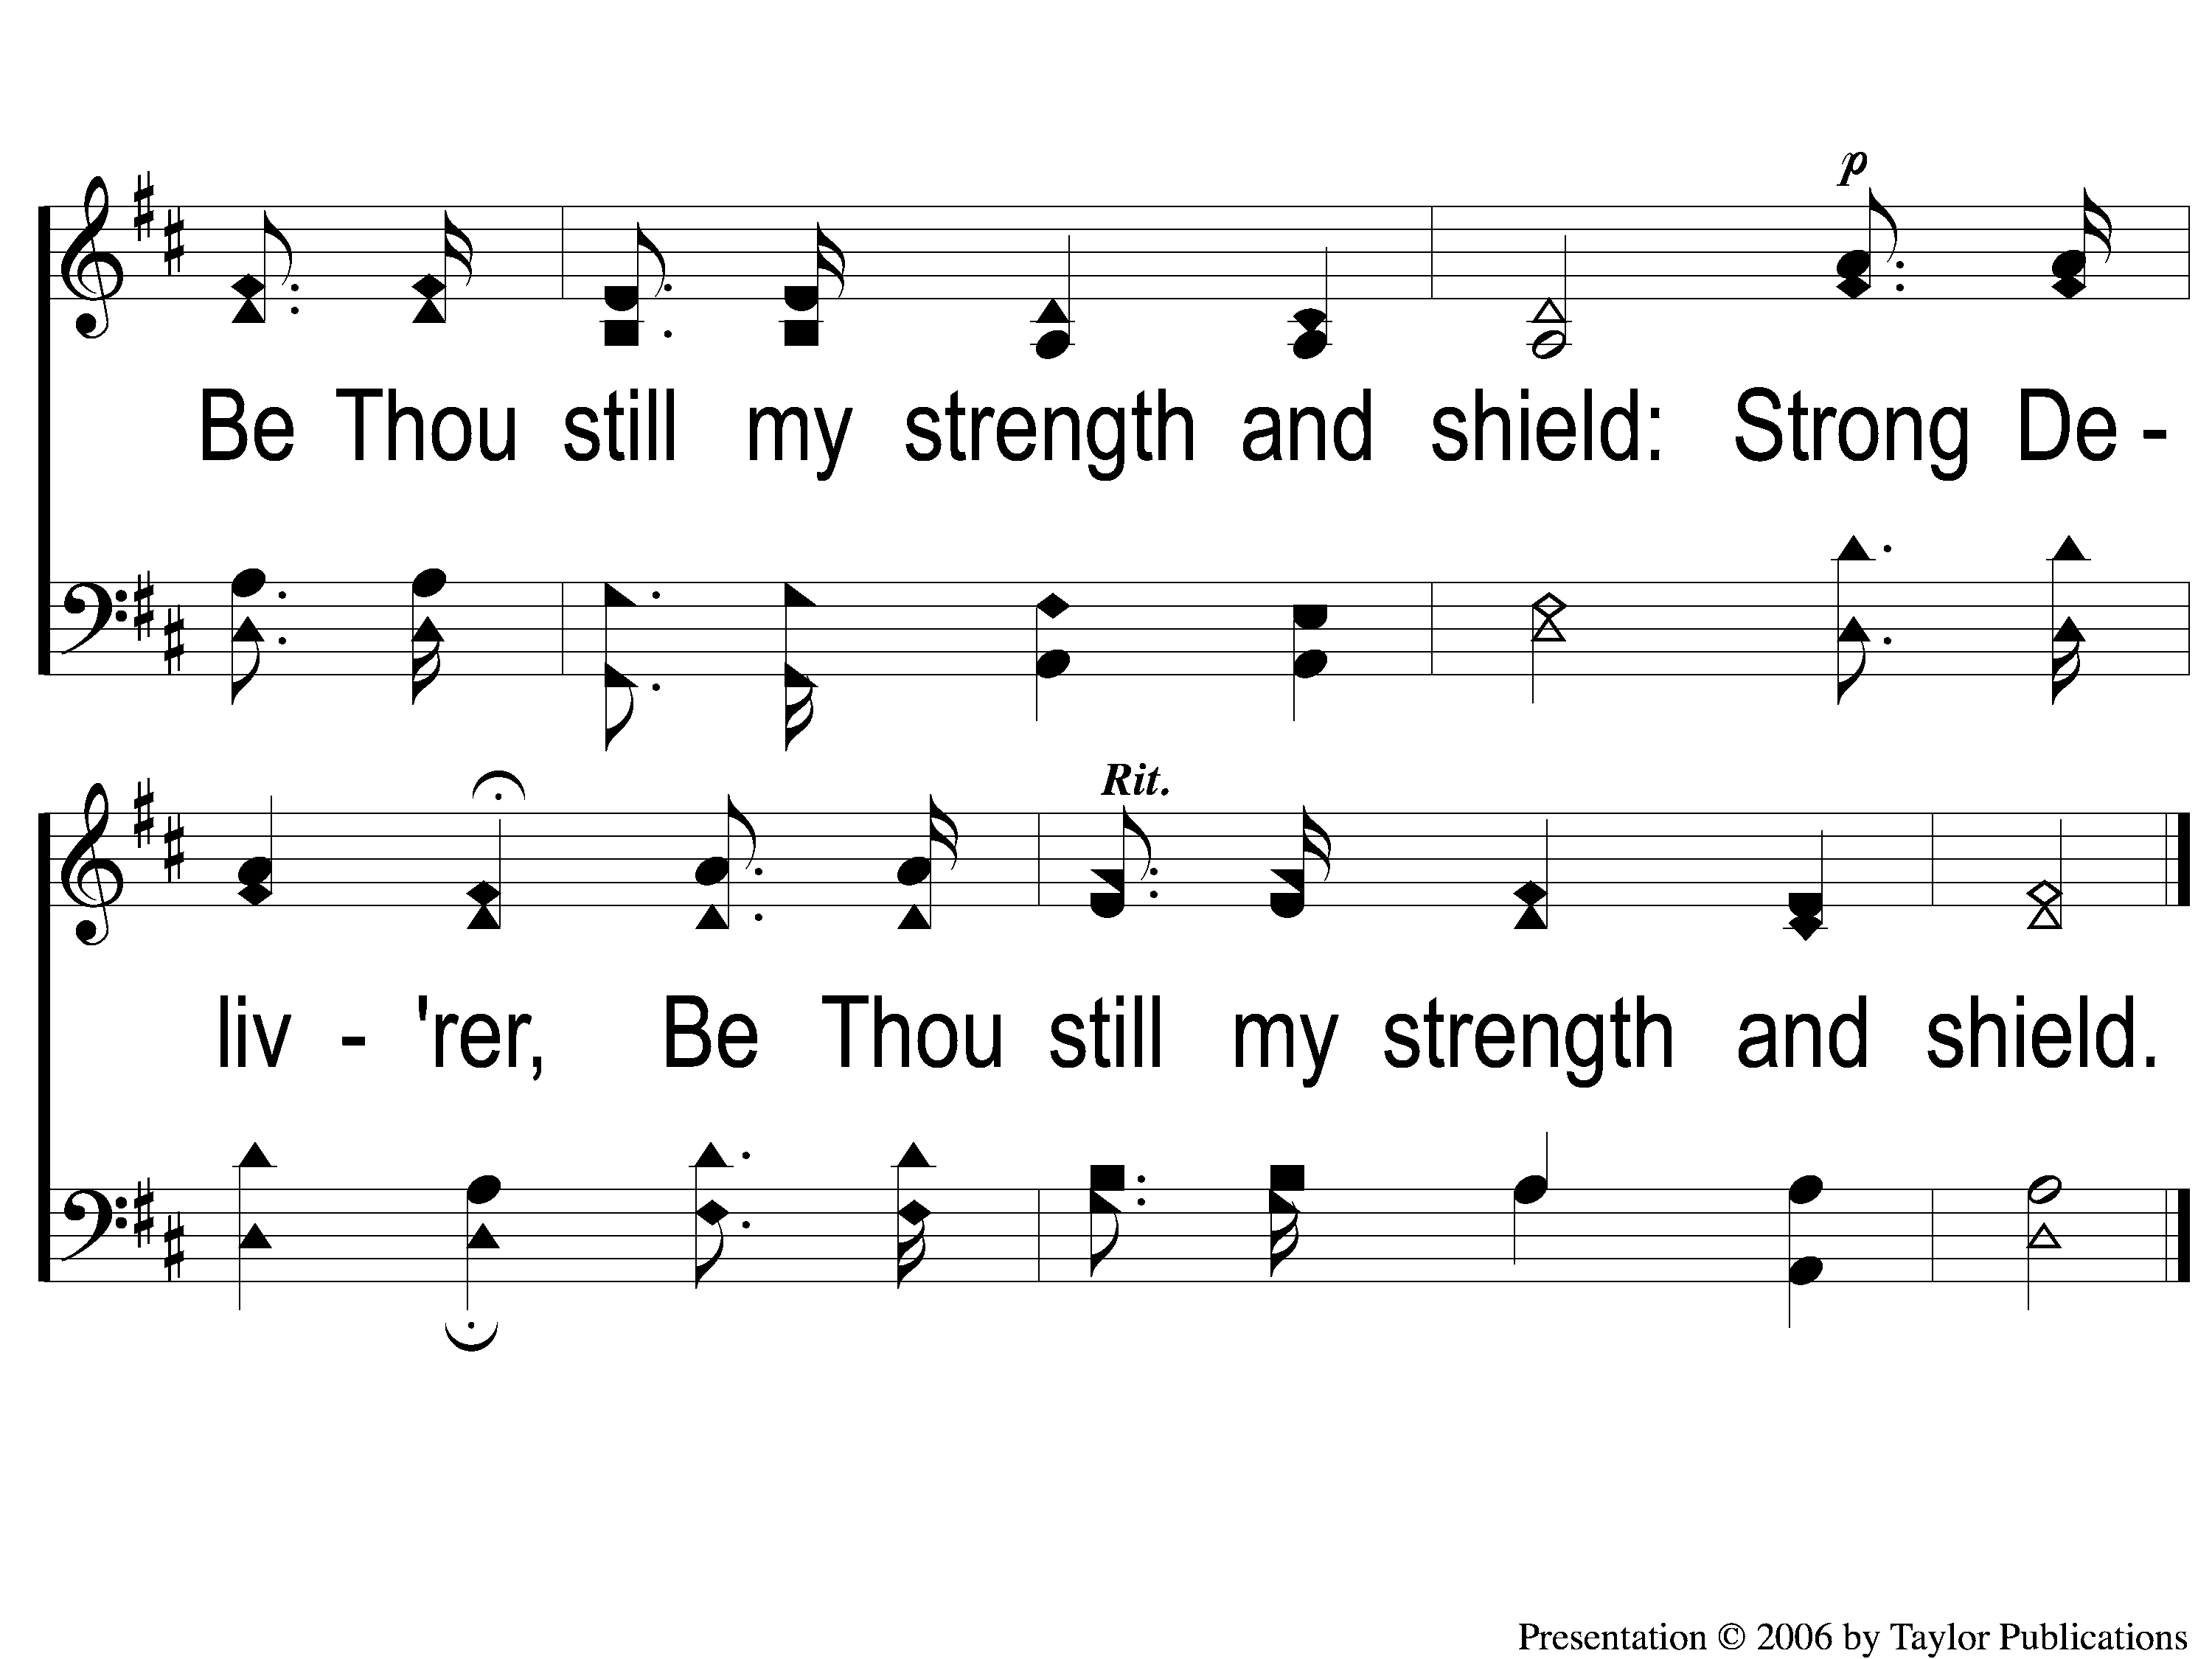
2-3 Guide Me O Thou Great Jehovah
Guide Me, O Thou Great Jehovah
141

Slide 7
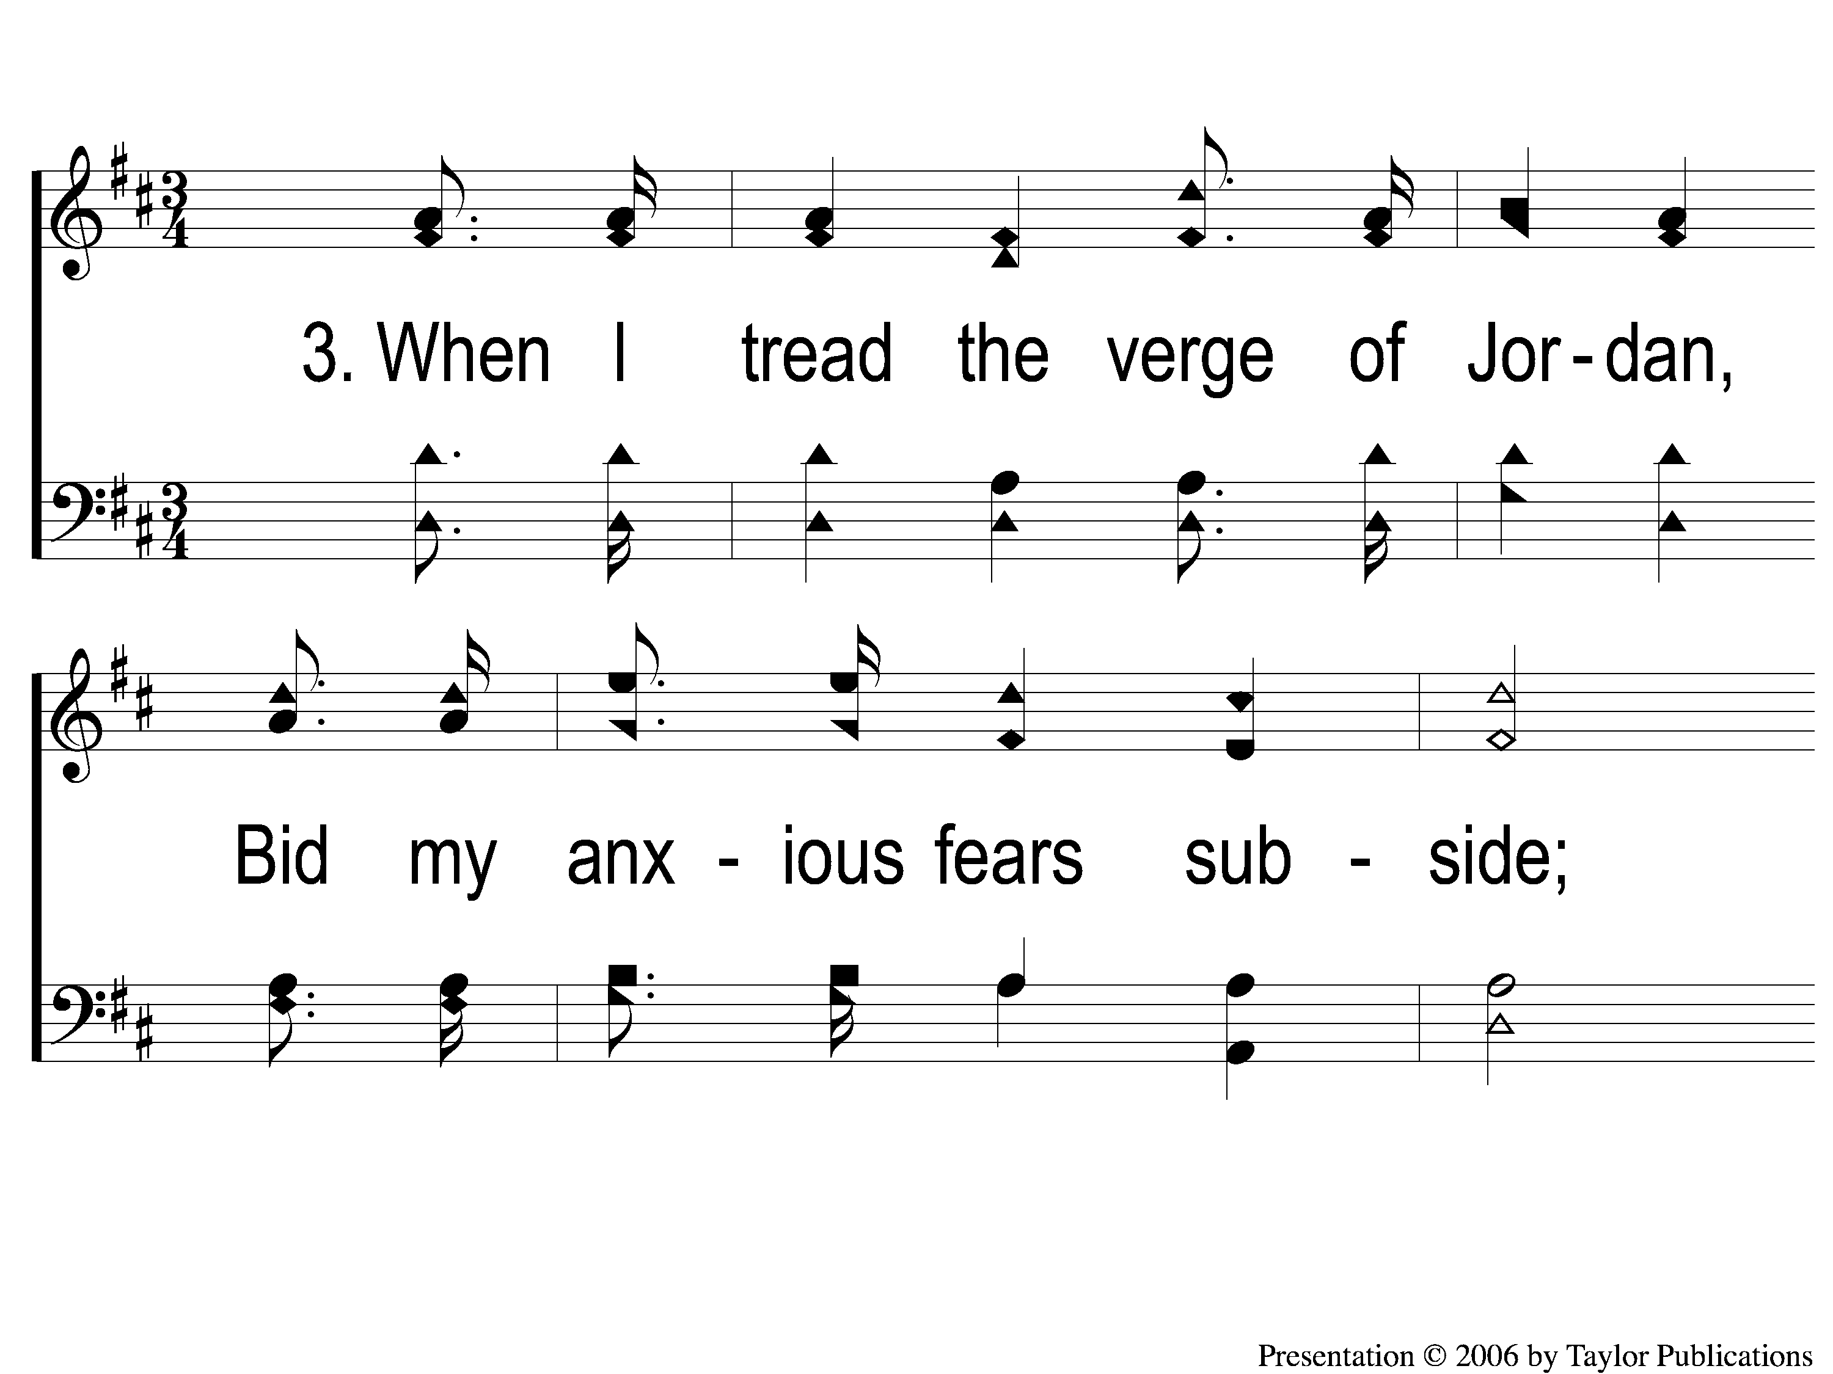
3-1 Guide Me O Thou Great Jehovah
Guide Me, O Thou Great Jehovah
141

Slide 8
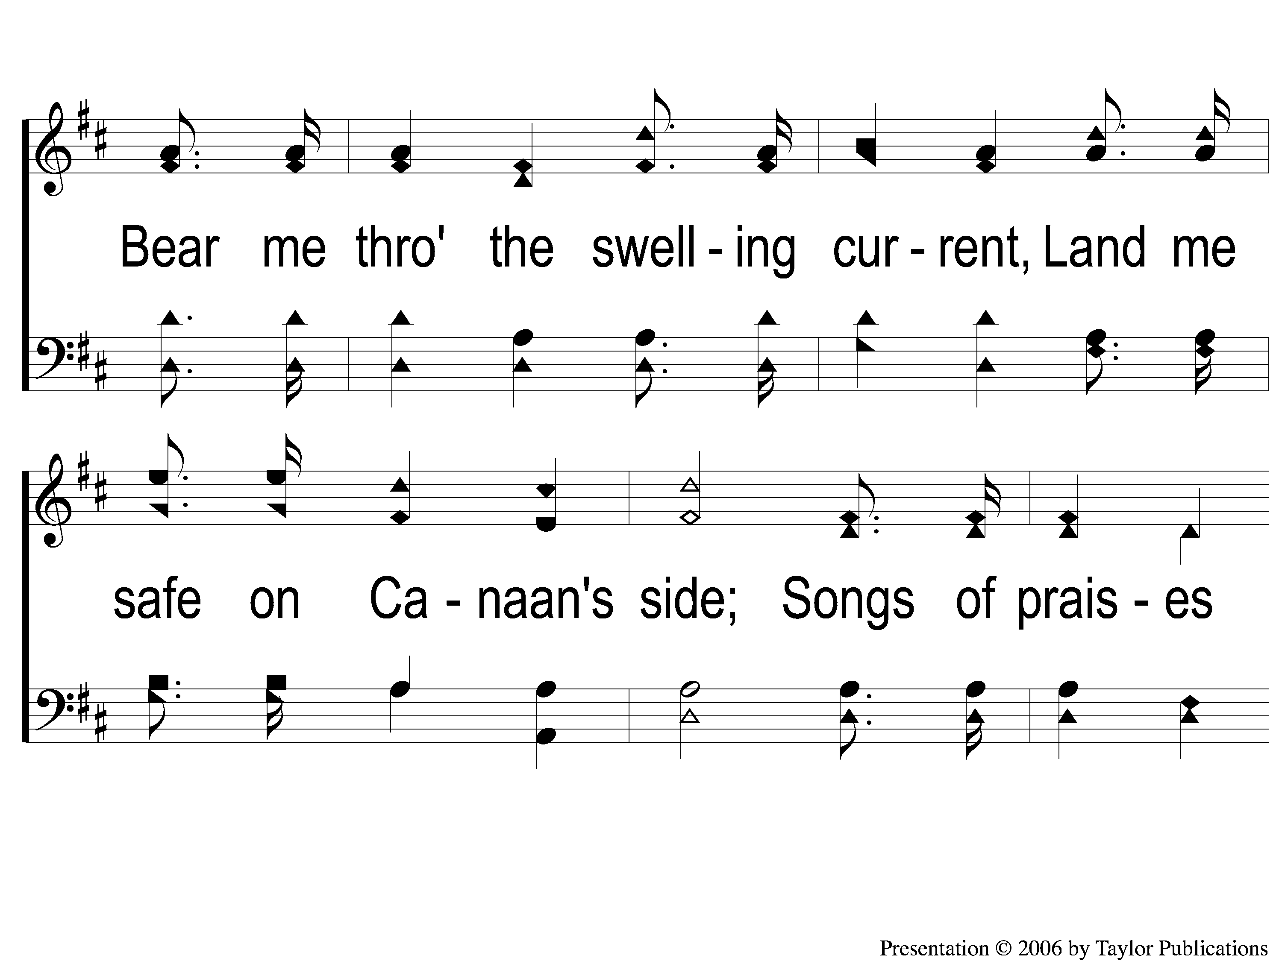
3-2 Guide Me O Thou Great Jehovah
Guide Me, O Thou Great Jehovah
141

Slide 9
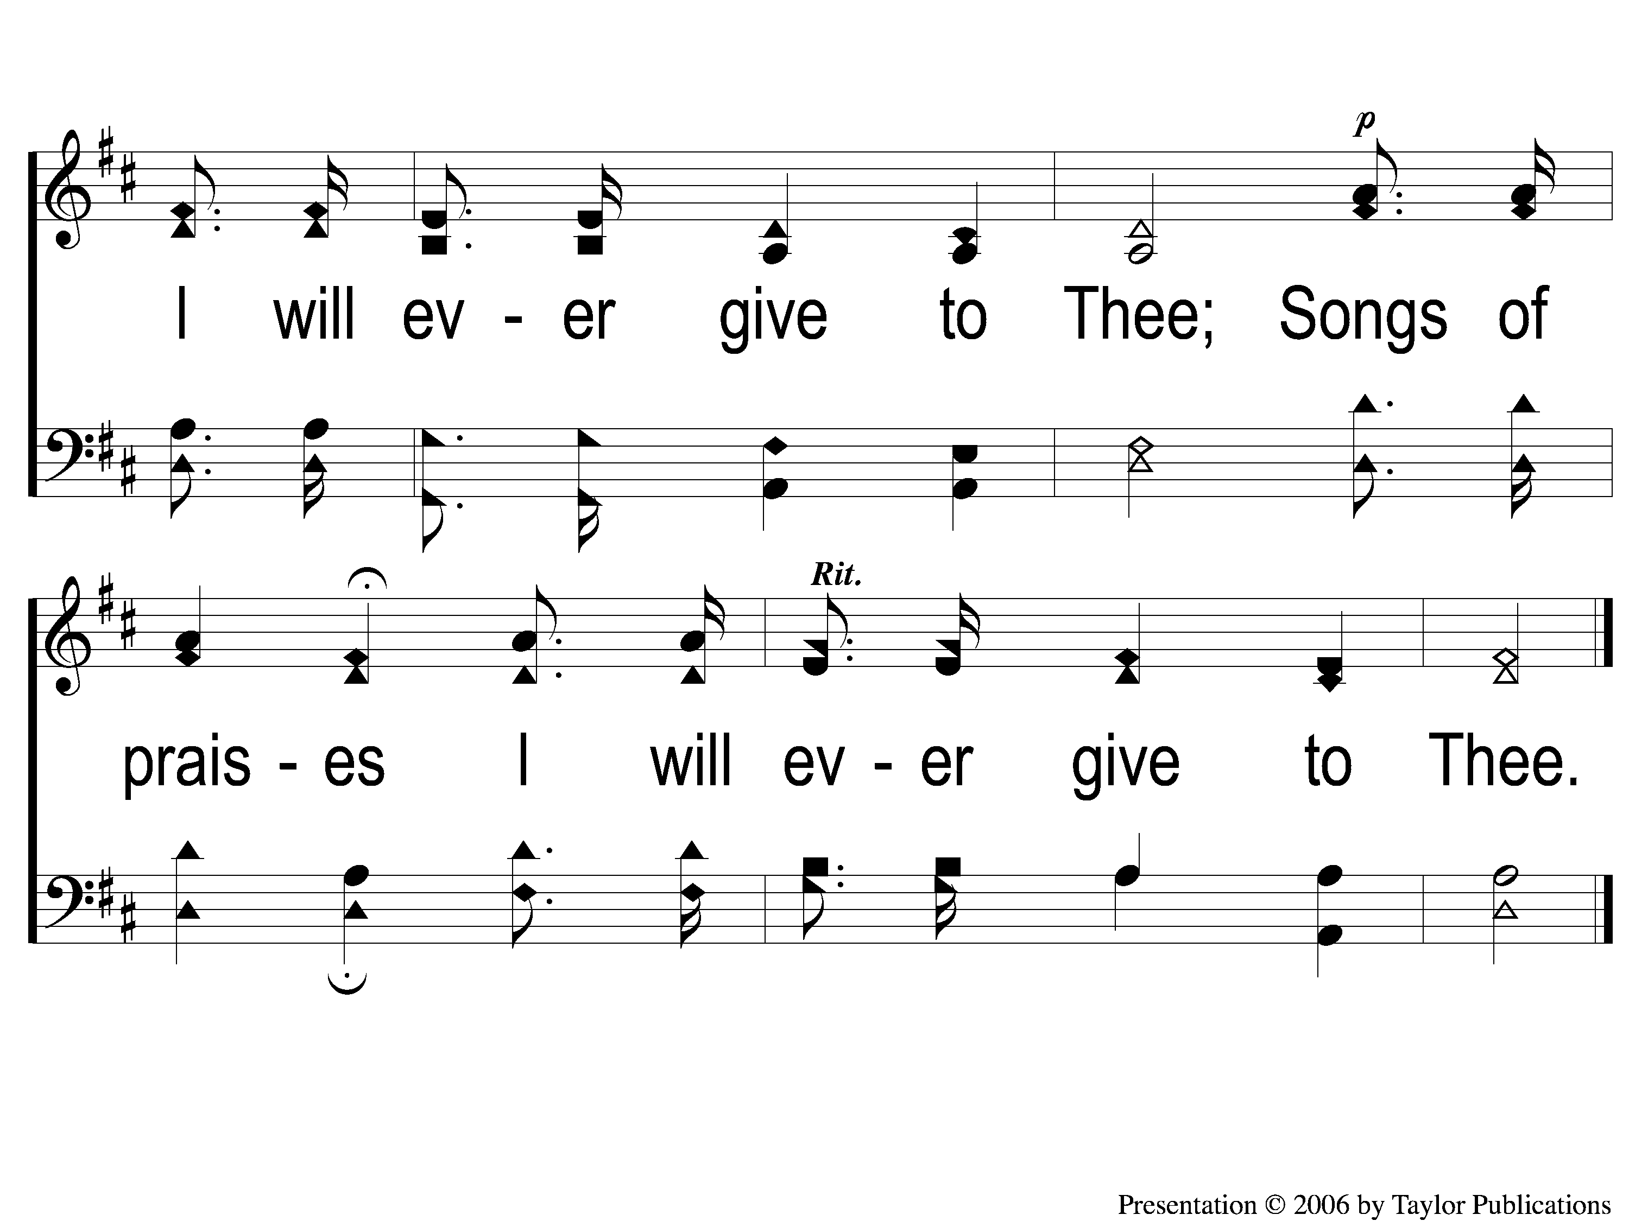
3-3 Guide Me O Thou Great Jehovah
Guide Me, O Thou Great Jehovah
141

